Slide 1











DESIGN THINKING
Title : Computer Network

Slide 2
INTRODUCTION
BACKGROUND
OBJECTIVE
OUR MODEL
Data can be transferred at a quicker rate if the speed of transmission is increased The larger the network, the more bandwidth is needed to handle the daily data transfer
To overcome the slow network in UTM. High bandwidth utilization also has an impact on how quickly users can upload and download files and media. To address this issue, our team developed a multipurpose router with several novel characteristics.
A router with an 8 GHz frequency band
Hex - the hexagonal shape of the router
Fi - model's ability to transmit Wi-Fi signals

Slide 3
DETAILED DESCRIPTION

Slide 4


DETAILED DESCRIPTION
PROBLEMS
SOLUTIONS
The usage of the connections inside the UTM is very large as everyone has at least two devices and more.
High bandwidth usage will happen as everyone tries to download and stream their file at the same time.
Network congestion- wifi signals slow down.
Invent a mini tri-band router (Hex-Fi).
This router contained 8GHz band.
The router can be accessed from far with higher speed and it is convenient to carry around.

Slide 5
DETAILED STEP

Slide 6


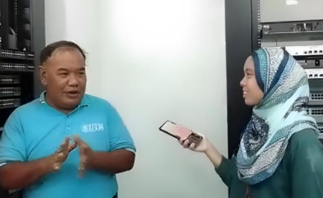
EMPATHY
= Conduct an interview with people that are more experienced in computer networks. This phases is to listened about their problem that they are facing through out the career.
Questions | Answers
What do you think can be improved in terms of network in our faculty? | In terms of the usage, in one particular time, all classes are using the network at the same time. So, the network might be slow because of the high bandwidth usage.
What are the challenges in managing networks in this faculty? | I think one of the challenges is technological change. For instance, nowadays, all of the students use laptops and Wi-Fi is growing fast. However, students are not satisfied with the connection of the Internet through Wi-Fi, so they need to use cable to connect it.

Slide 7

DEFINE
= To diagnosed and identify the problem that our respondent has faced during their career.
High bandwidth usage occurs when everyone is using the internet at the same time.
One person has more than one device connected to the internet.
CONNECTIVITY OF THE INTERNET IN THE UTM IS NOT AS FAST AS IT SHOULD BE
Too many requests in transferring data.
Everyone is trying to download the files and stream music and video at the same time.
WI-FI SIGNAL WILL SLOW DOWN FROM TIME TO TIME

Slide 8

IDEATE
= To generate all the possible solutions to overcome the problem statements.
CREATE A NEW TYPE OF FIBER OPTIC CABLE THAT HAVE A HIGHER BANDWIDTH USAGE
CREATE A WIRELESS ROUTER WITH HIGHER FREQUENCIES WHICH IS 8GHZ
A fiber optic cable can provide a higher speed of network but it will be costly and expensive.
Creating the cable with a recycled material may result in poor performance as it is not a good electric conductor.
This will provide faster speeds and more stable connections.
The shorter waves make it less able to penetrate walls and solid objects. So, it provides internet at a shorter range. By making it portable, this issue won’t be a problem as it can be brought anywhere you go.

Slide 9

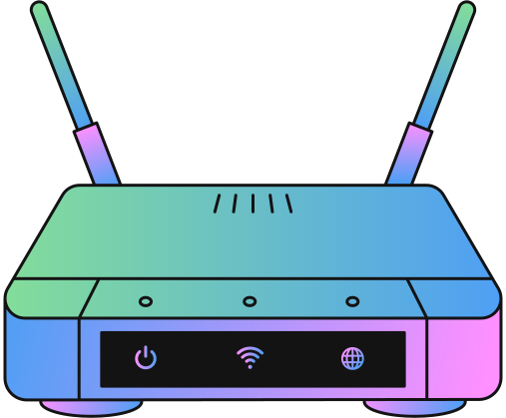
PROTOTYPE
= To choose the most suitable solution to the problem that has been identified.
PROVIDE FASTER SPEEDS AND MORE STABLE CONNECTIONS.
Has higher frequency and internet at a shorter range.
People can access the internet anywhere they want with a faster speed. The router is very user-friendly because it is very easy to take care of and it is small, which will not take up much space in your bag.
PORTABLE ROUTER

Slide 10
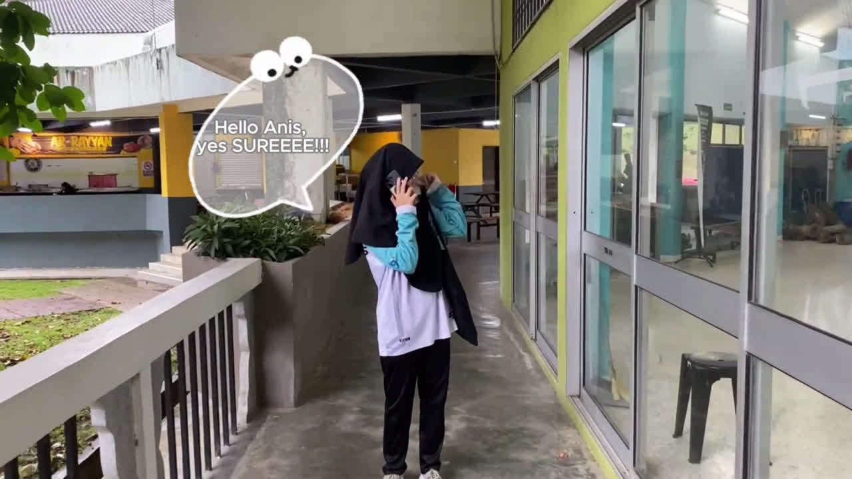
TEST
= To show and explain our product to the users.

Slide 11
THANK YOU VERY MUCH!
by Group 11

